Slide 1
T
TRISHNA 3D
See the home
beyond the plan.
Turn architectural drawings into interactive 3D spaces.
A browser-based architectural walkthrough studio
For architects · project teams · future homeowners
DevDay Exchange Community Hackathon · Kochi · 2026
Notes:
Introduce the product and its users. Trishna 3D turns architectural drawings into interactive 3D walkthroughs.
Source: README.md; src/components/BuildingViewer3D.tsx

Slide 2
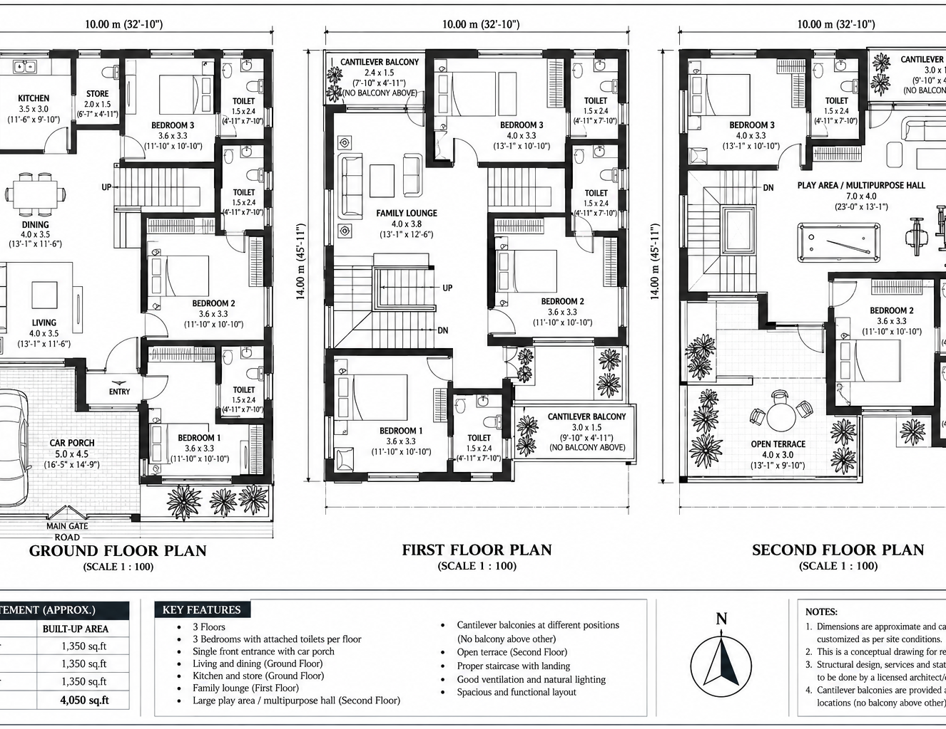
PROBLEM STATEMENT
A flat plan leaves too much
for people to imagine.
The drawing records measurements and layout, but people still have to picture the finished space.
DEPTH
Will these rooms feel spacious?
CIRCULATION
How do the stairs connect each floor?
CONFIDENCE
What will it feel like to move through the home?
Sample plan · three levels · 10 m × 14 m
02
Notes:
Use the three questions to make the problem concrete: a plan shows the arrangement, but the experience of depth, circulation and movement is harder to judge from lines alone.
Source: public/extracted.png; public/three-floor-residence-drawing.pdf; README.md

Slide 3
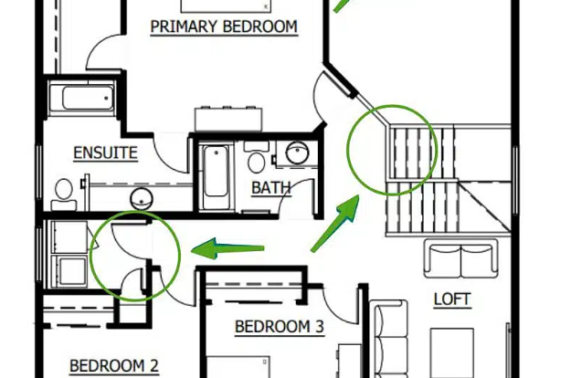
PROPOSED SOLUTION
Upload a plan. Explore a home.
Trishna 3D turns a drawing into a navigable model.
01
READ
02
INTERPRET
PDF.js parses vector and raster plans in the browser.
Optional Gemini Vision helps analyze new uploads.
03
RECONSTRUCT
04
EXPLORE
A structured plan drives walls, floors, doors and stairs.
Orbit the model or walk through connected levels.
03
Notes:
The flow is upload, interpret, reconstruct and explore. PDF.js handles document parsing. Gemini Vision is optional for analyzing new uploads. The browser renders a procedural model, which viewers can orbit or navigate in first person.
Source: README.md; src/utils/parseFloorPlanPdf.ts; src/utils/geminiPlanAnalyzer.ts; src/components/BuildingViewer3D.tsx

Slide 4
WHAT WORKS TODAY
A working prototype—not just a mock-up.
The demo combines plan input, procedural assembly and live navigation.
01
02
03
INPUTS
BUILD
WALKTHROUGH
PDF · PNG · JPG
7 seconds
3 floors
Read vector or raster PDFs and image plans. Built-in sample plans run without an API key.
Watch the model assemble from ground level up, with walls, floor slabs and a stair core.
Switch between orbit and first-person views; climb between floors and approach doors to open them.
LIVE SAMPLE
10 m × 14 m residence plan · progressive build · walkable stair connections
04
Notes:
Show the live model here. The sample home uses a 10 by 14 metre plan and three storeys. Its construction animation takes seven seconds. Viewers can orbit, switch to first-person and climb connected stairs. Custom-plan Gemini analysis requires an API key; the bundled samples do not.
Source: README.md; src/components/BuildingViewer3D.tsx; src/data/sampleResidencePlan.ts; SUBMISSION.md

Slide 5
SCALABILITY
Start with one home. Build toward more.
Scale the capabilities in steps—and make the limits visible.
TODAY
Browser workflow
PDF, PNG and JPG inputs; local rendering; a built-in three-floor sample.
NEXT
Broader interoperability
DXF / IFC export is a roadmap item, not part of the prototype.
LATER
More immersive review
WebXR headset walkthroughs are a future direction.
What must scale too
Test varied drawings, improve extraction confidence and validate performance on more devices.
05
Notes:
Be explicit that today’s input formats and sample are working prototype capabilities. DXF/IFC export and WebXR are roadmap items. To scale responsibly, test more drawing styles, improve extraction confidence and measure performance across devices.
Source: README.md; SUBMISSION.md; previous pitch roadmap; limitation: hand-drawn parsing depends on Gemini quality and API availability

Slide 6
SUSTAINABILITY
Better spatial decisions,
earlier in the process.
A PRACTICAL
OPPORTUNITY
A walkthrough can support clearer design conversations before construction.
01
VISUALIZE
Walk through the proposed layout.
01
DESIGN REVIEW
Spot circulation or room-layout questions while options are still open.
02
DISCUSS
Share questions in one 3D view.
02
SHARED UNDERSTANDING
Give clients and project teams a common view to discuss.
03
REVIEW EARLY
Consider changes before construction.
03
DIGITAL DELIVERY
Built-in samples run in the browser without a cloud-rendering queue.
Prototype does not calculate material use, carbon, or device energy.
Notes:
Describe sustainability as a plausible benefit, not a result already measured. A shared 3D view may help teams raise design questions earlier; no material, carbon or energy savings have been calculated. Local rendering avoids a cloud-render queue, but still uses device energy.
Source: README.md; src/components/BuildingViewer3D.tsx; sustainability claims are explicitly qualified as potential

